Slide 1
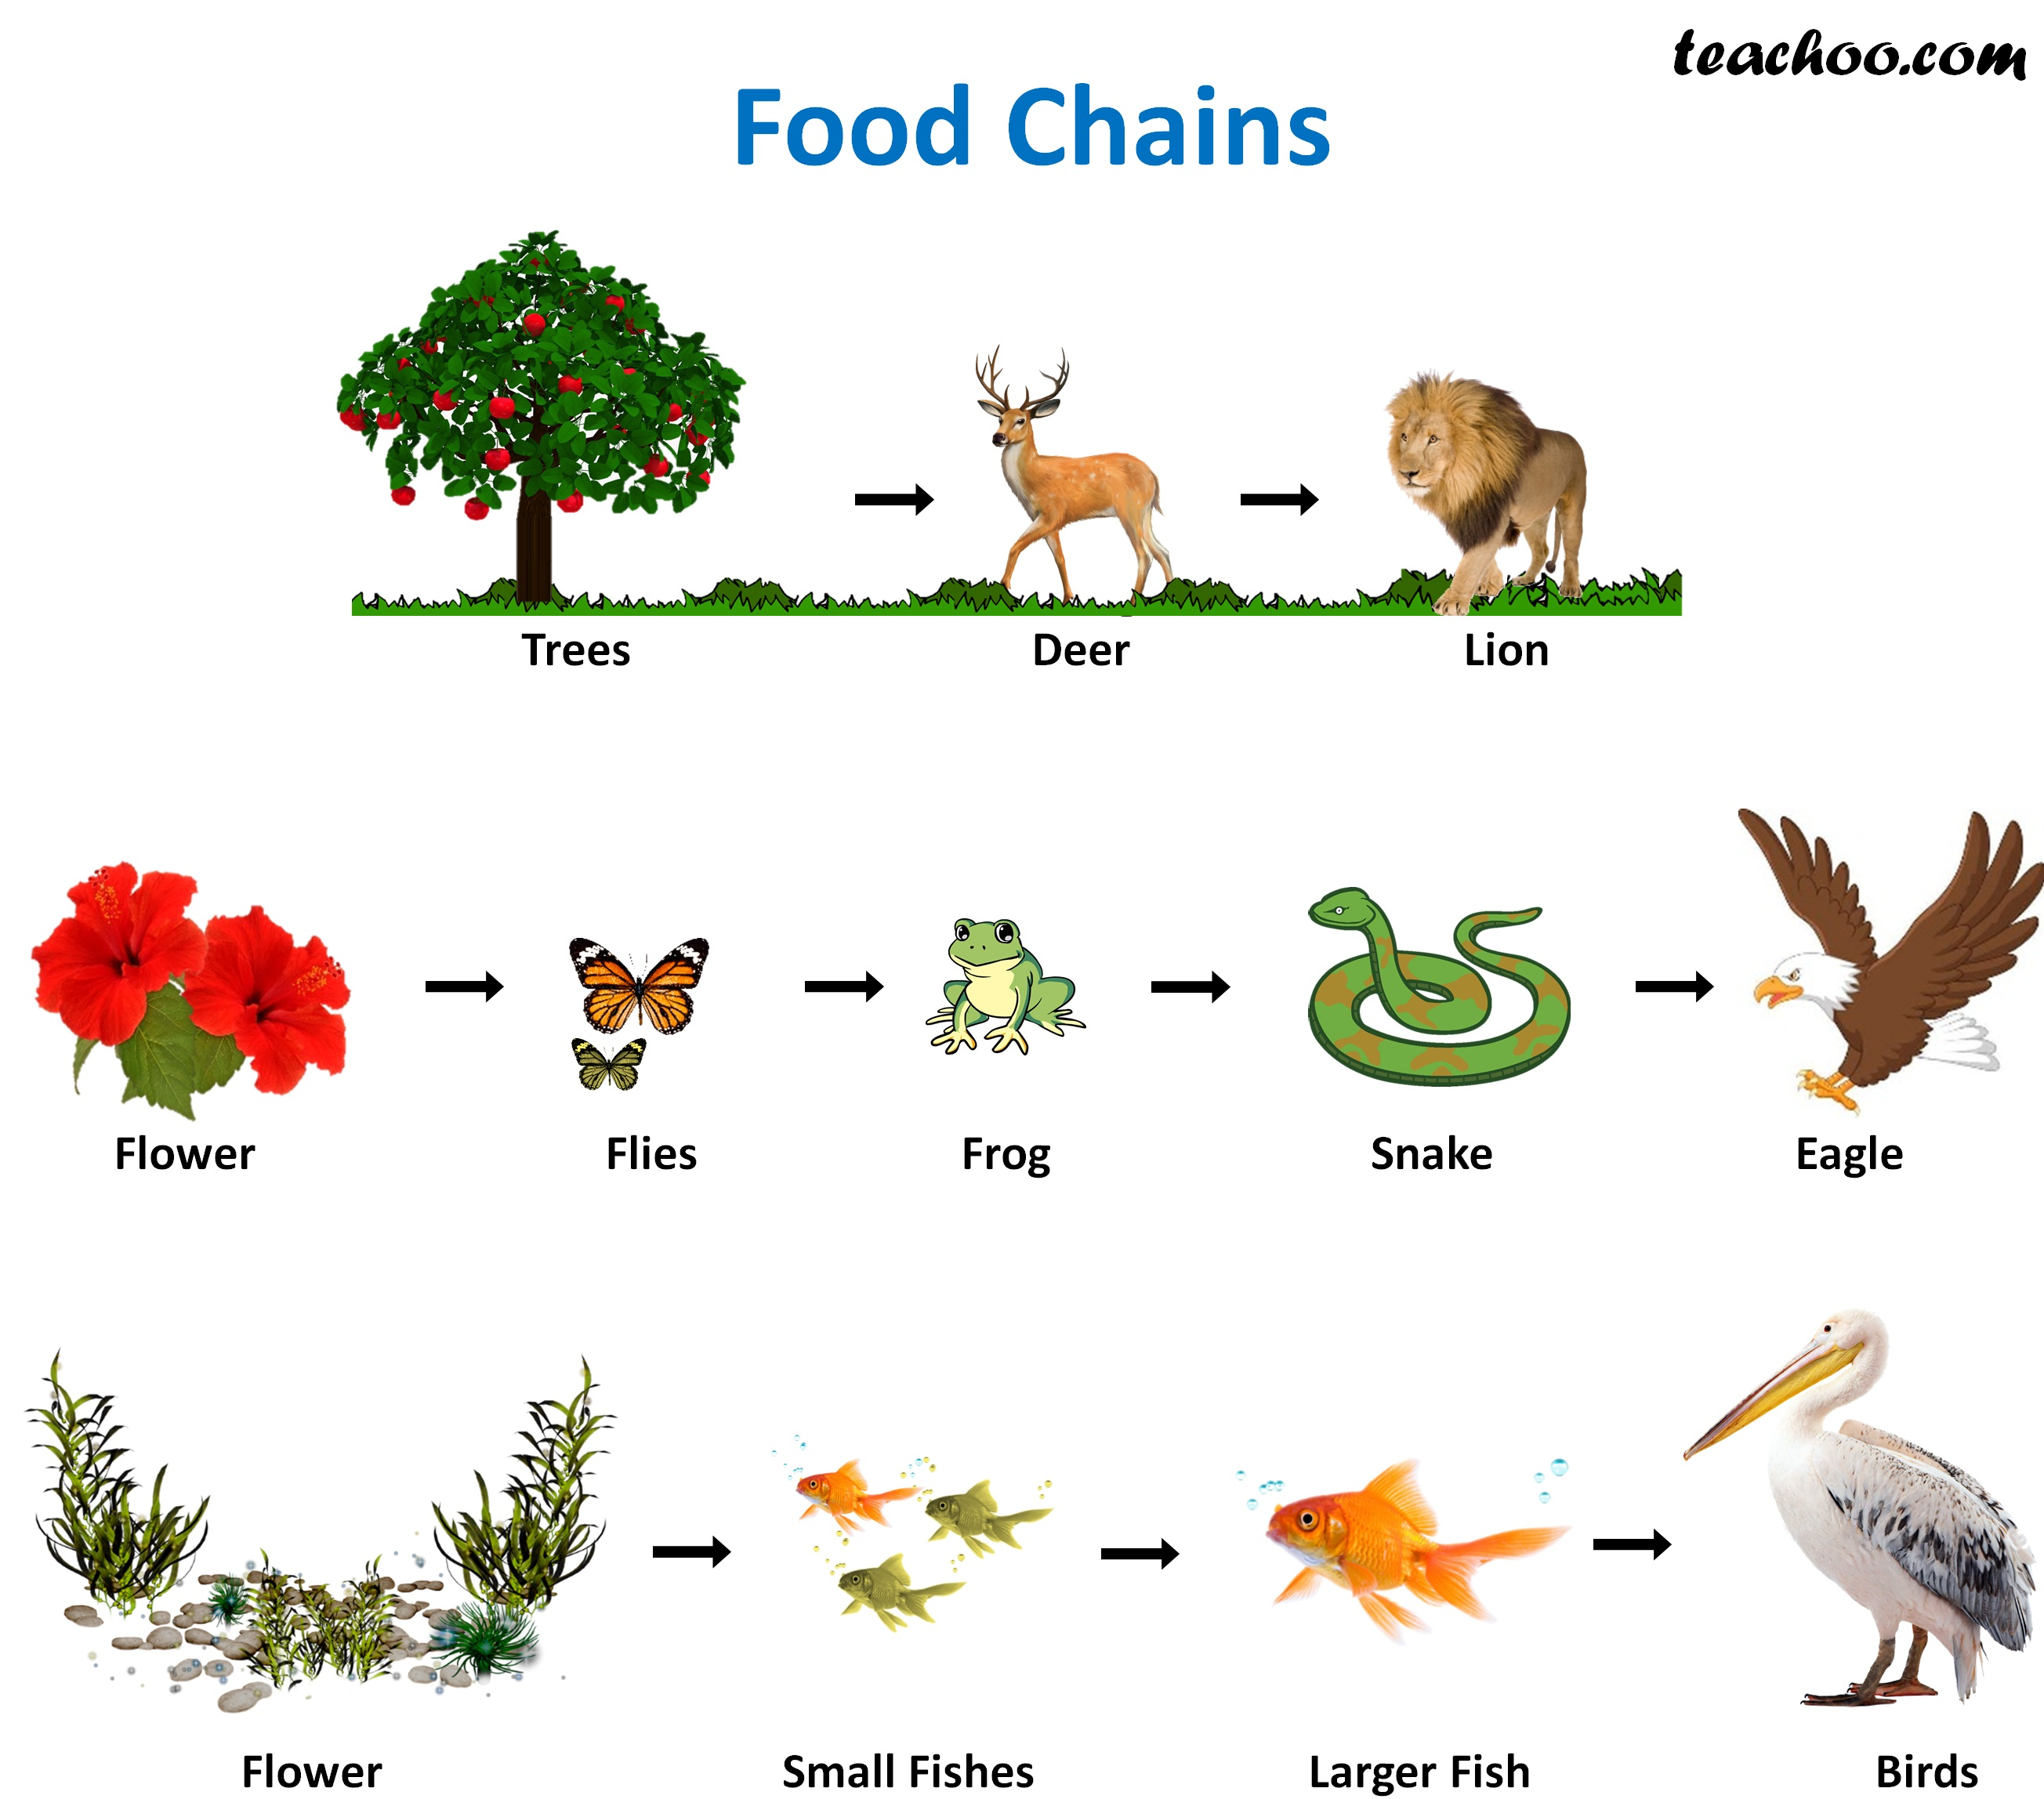
Food Chain Examples – Page 1
In the following passage, underline or highlight all the key-words and information. Then, answer the questions on the back
A food chain is a way of showing how energy moves through an ecosystem. Energy starts with the sun, which helps producers like plants and algae make food. Consumers like animals then eat the plants and algae to get energy. Each animal is eaten by another animal, and this continues on and on. The 10% rule says that only about 10% of the energy is passed from one animal to the next. So, if a plant makes 100 units of energy, a herbivore that eats the plant only gets 10 units of energy, and a predator that eats the herbivore only gets 1 unit of energy. Food chains are important because they show how every animal in an ecosystem relies on another for food and energy.
Trees are producers, which means they make their own food from the sun. Deer are consumers, which means they eat other things to get energy. Lions are also consumers, and they eat deer. In this food chain, trees make food for deer, and deer are food for lions. If there were too many deer, they would eat all the trees and plants, but lions help keep their numbers in check.
Another food chain starts with flowers, which are producers. They make food from the sun and provide nectar for insects like flies, which are consumers. Frogs are also consumers, and they eat flies. Snakes are consumers too, and they eat frogs. Eagles are at the top of the food chain, and they eat snakes. So, in this food chain, flowers make food for flies, and flies are food for frogs, and so on.
In the ocean, the food chain starts with flowers, which are producers. They make their own food from the sun. Small fish like anchovies are consumers, which means they eat other things to get energy. Larger fish like tuna are also consumers, and they eat the smaller fish. Birds like seagulls and pelicans are at the top of the food chain, and they eat the larger fish.

Slide 2
Food Chain Examples – Page 2
What does a food chain show?
______________________________________________________________________
What is the 10% rule in a food chain?
______________________________________________________________________
What is the first food chain shown?
What is the role (are they a producer or consumer) for each organism?
Trees: __________________________________________________________
Deer: __________________________________________________________
Lions: __________________________________________________________
What is the second food chain shown?
What is the role (are they a producer or consumer) for each organism?
Flower: __________________________________________________________
Flies: __________________________________________________________
Frog: __________________________________________________________
Snake: __________________________________________________________
Eagle: __________________________________________________________
Why is the third food chain shown?

